Slide 1
Past Continuous Tense
Basic and Junior VIOL

Slide 2
Structure of Past Continuous
Subject +was/were+ verb +ing(affirmative)
Subject+wasn’t/were’nt+verb+ing(negative)
Was/Were+subject +verb +ing(interrogative)

Slide 3
Indicators of Past Continuous
As
While
When

Slide 4
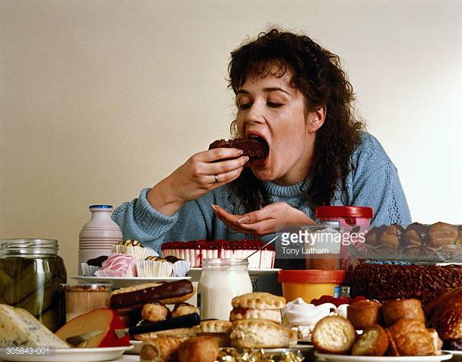
Uses of Past Continuous
To talk about an action going on at a particular time in the past.
eg:At 8 0’clock this morning I was having breakfast.

Slide 5
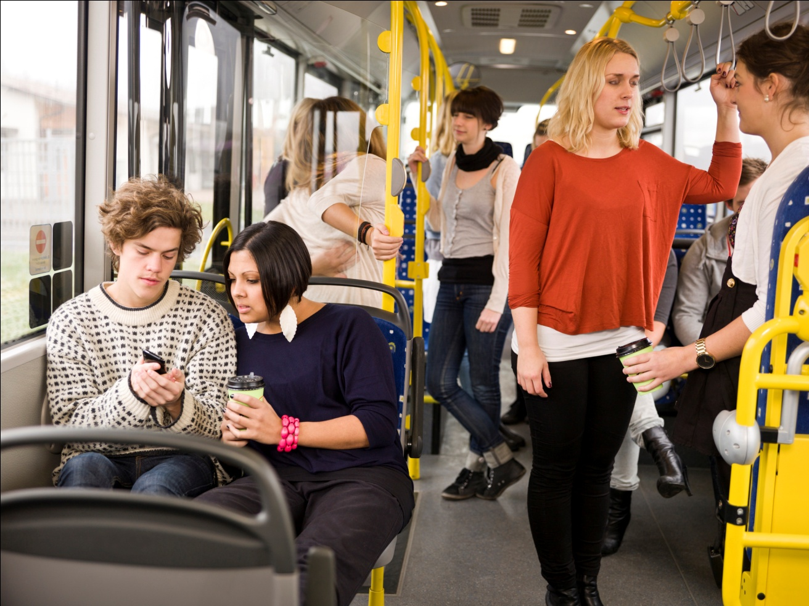
At this time yesterday we were travelling.

Slide 6
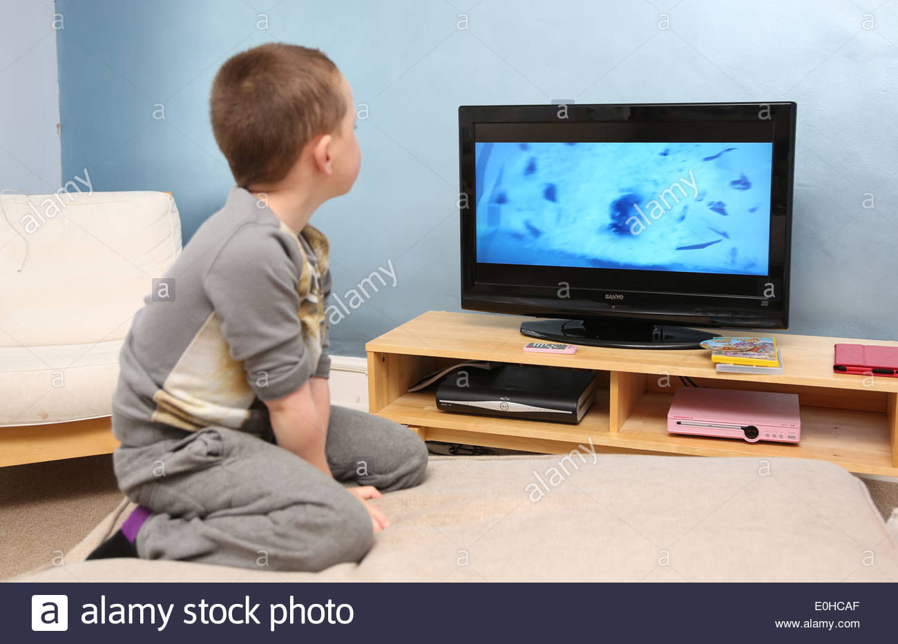
Last evening I was watching TV.

Slide 7
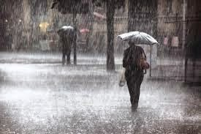
To talk about long continuous actions in the past. Eg:It was raining all day yesterday.

Slide 8

We were shopping the whole day yesterday.

Slide 9

To talk about a continuing action interrupted by another short action.eg: When I was watching tv my friend called me.

Slide 10
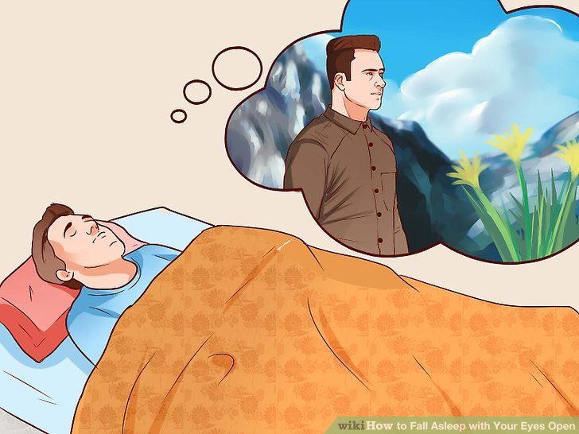
When I was sleeping l saw a dream.

Slide 11
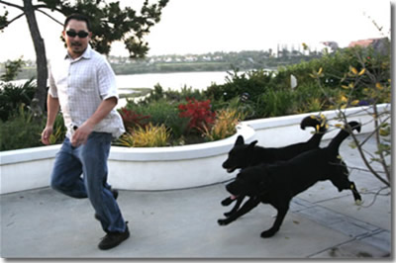
When he was walking two dogs chased him.

Slide 12

To talk about two actions going on in the past simultaneously.eg:when the teacher was teaching the students were listening.

Slide 13
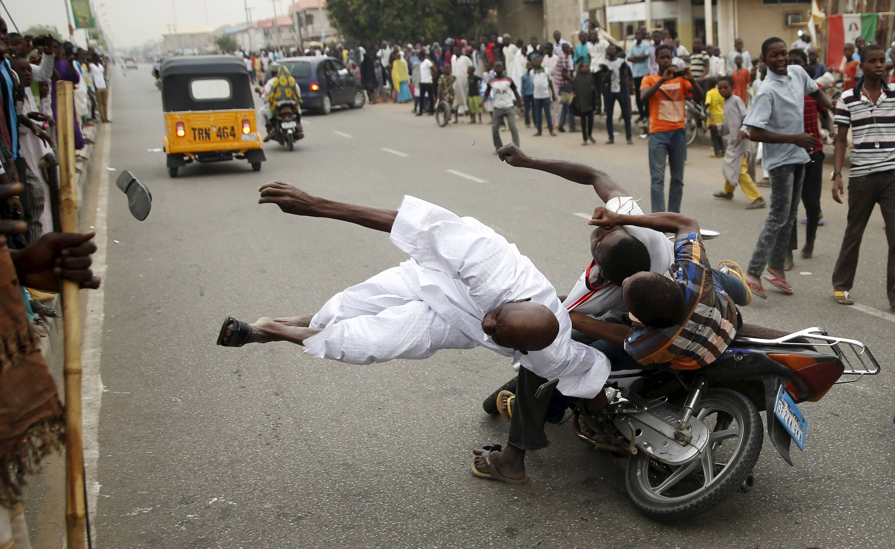
When he was crossing the road a bike hit him.

